Slide 1
Introduction to Java
Class 8:
GUI and Applets

Slide 2
Introduction
Command line applications seem outdated and boring, right? There are still people who use it. In engineering, science, astronomy, IT and many other fields.

Slide 3
Introduction
GUI stands for Graphical User Interface. You pretty much HAVE TO implement it if your application’s target is the general public.

Slide 4
Introduction
GUI stands for Graphical User Interface. You pretty much HAVE TO implement it if your application’s target is the general public.

Slide 5
OOP Basics
Classes are like data types. Methods are functions and they are part of classes. Objects are the product of classes.

Slide 6
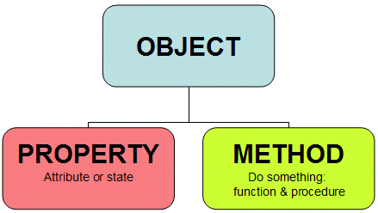
OOP Basics

Slide 7
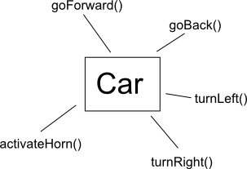
OOP Basics

Slide 8
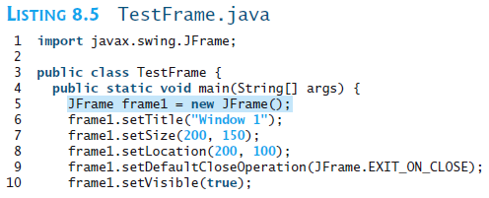
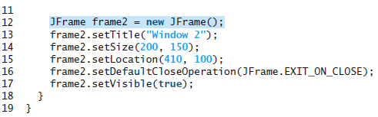
Displaying GUI Components

Slide 9
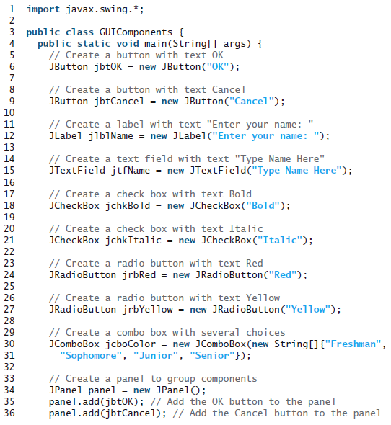
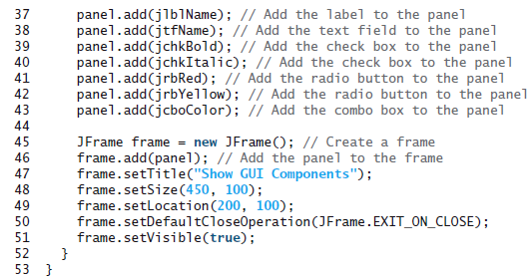

Slide 10
Swing vs. AWT
When Java was introduced, the GUI classes were bundled in a library known as the Abstract Windows Toolkit (AWT). AWT is fine for developing simple graphical user interfaces, but not for developing comprehensive GUI projects. In addition, AWT is prone to platform-specific bugs. The AWT user-interface components were replaced by a more robust, versatile, and flexible library known as Swing components.

Slide 11
Swing vs. AWT
Swing components are painted directly on canvases using Java code, except for components that are subclasses of java.awt.Window or java.awt.Panel, which must be drawn using native GUI on a specific platform. Swing components depend less on the target platform and use less of the native GUI resource.

Slide 12
Swing vs. AWT
To distinguish new Swing component classes from their AWT counterparts, the Swing GUI component classes are named with a prefixed J. Although AWT components are still supported in Java, it is better to learn how to program using Swing components, because the AWT user-interface components will eventually fade away.

Slide 13
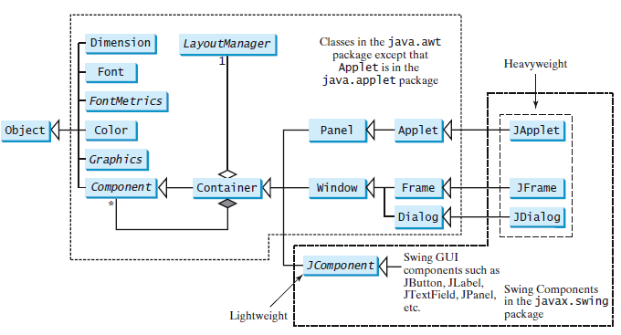
The Java GUI API

Slide 14
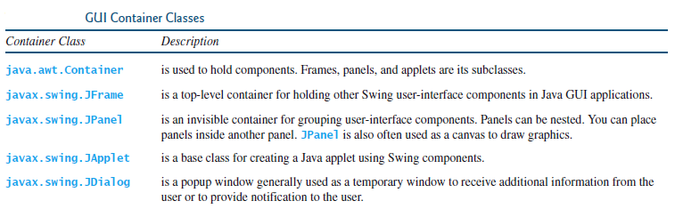
GUI Container Classes

Slide 15
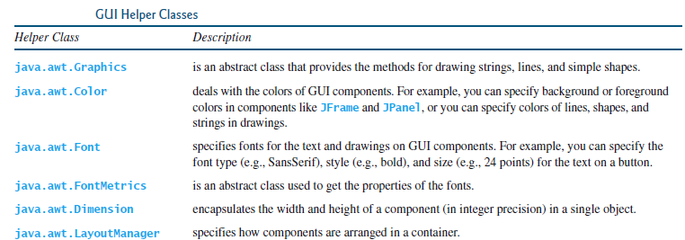
GUI Helper Classes

Slide 16
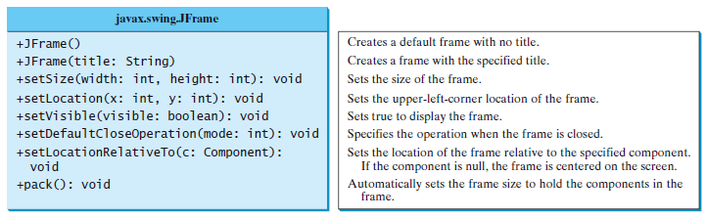
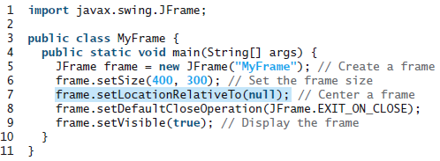
Creating a Frame

Slide 17
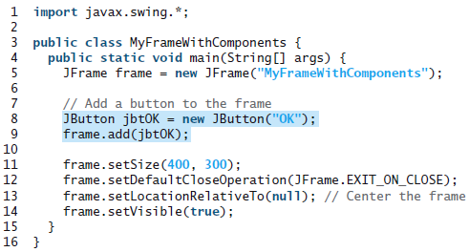
Adding Components

Slide 18
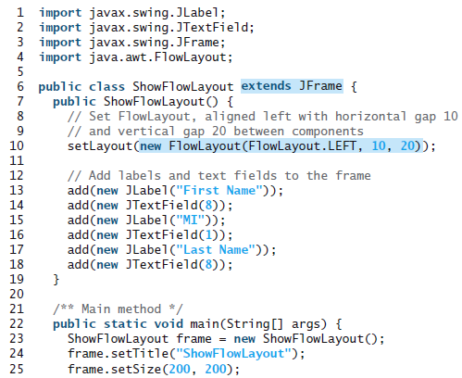

Layout Managers

Slide 19
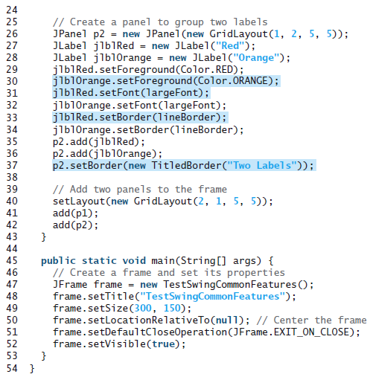
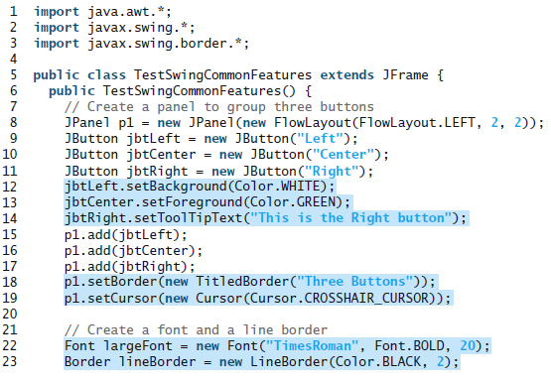
Swing Common Features

Slide 20
Developing Applets
Java applets are instances of the Applet class. JApplet is a subclass of Applet, and it is suitable for developing applets using Swing components.

Slide 21


Developing Applets

Slide 22
<applet> HTML tag
To run an applet, you need to create an HTML file with an <applet> tag for embedding the applet.

Slide 23
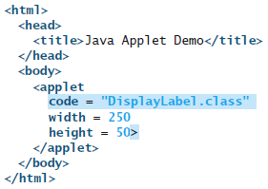

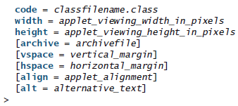
<applet> HTML tag

Slide 24
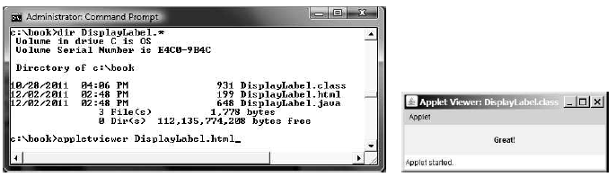
Applet View Utility

Slide 25
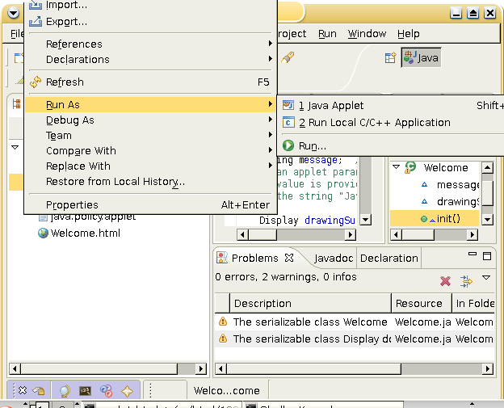
Applet View Utility

Slide 26
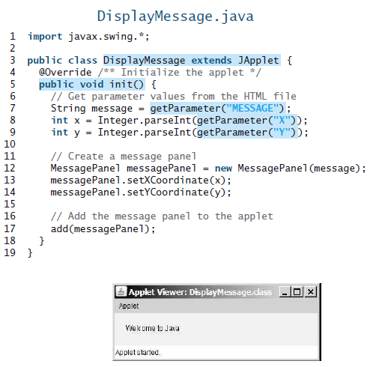
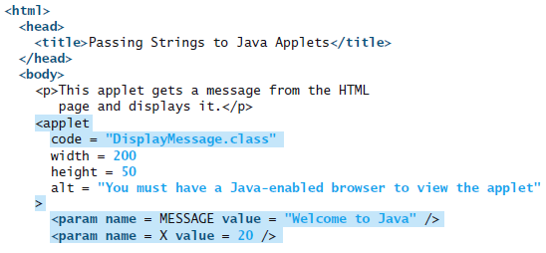

Passing Strings to Applets

Slide 27
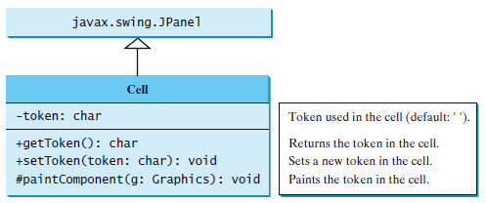
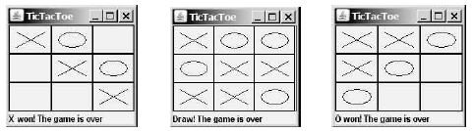
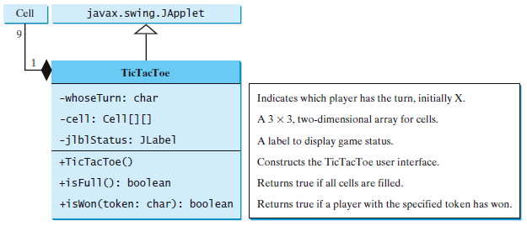
Case Study: TicTacToe

